Slide 1
Something Interesting Is A HAPPENING
@

Slide 2

The World’s Largest Taxi Company Owns No Vehicles
UBER
@

Slide 3

The world’s most popular media owner owns no content
FACKBOOK
@

Slide 4

The world’s most valuable retail owner owns no inventory
Alibaba
@

Slide 5

The world’s largest accommodation provider, owns no real estate
AIRBNB
@

Slide 6

what is our topic ?
What is common in Uber, Facebook, Alibaba, Airbnb?
@

Slide 7
Entrepreneurship
UBER
FACEBOOK
ALIBABA
AIRBNB
The most common thing in these companies is entrepreneur spirit. They have an idea and work on that.
@

Slide 8








400 million are entrepreneurs
430 million are employed
5.6%
6%
577 million are older than 64
26.4%
8%
1.9 billion are too young to work ages(0-15)
What do
7 billion people
do?
11.1%
800 million work industrial job
1.7 billion work in service
1.4 billion work on agriculture
19.4%
23.6%
@

Slide 9
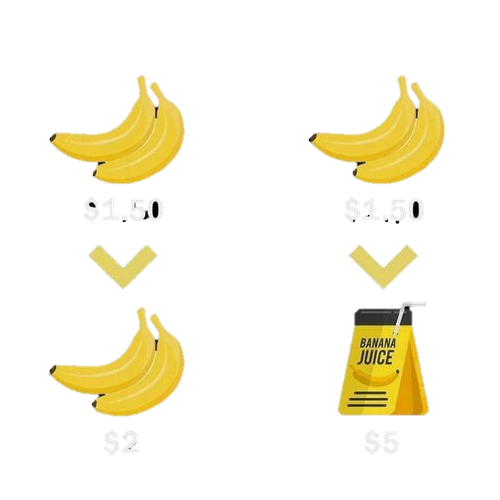
Businessman
Entrepreneur
A businessman is a person who sets up an existing idea
Creates place in existing markets
Market player
Less risk
Profit orientation
Very high competition
A entrepreneur is a person who starts with new idea
Creates new market
Market leader
Comparatively high risk
People orientation
Low competition
v
s
@

Slide 10
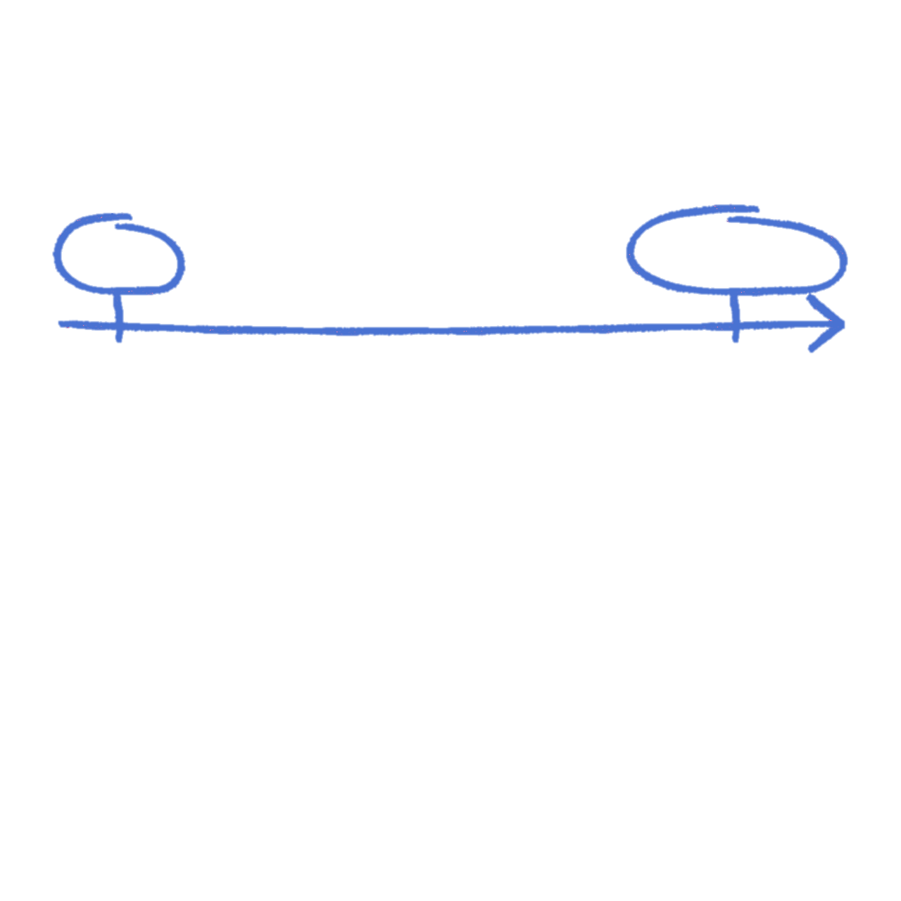
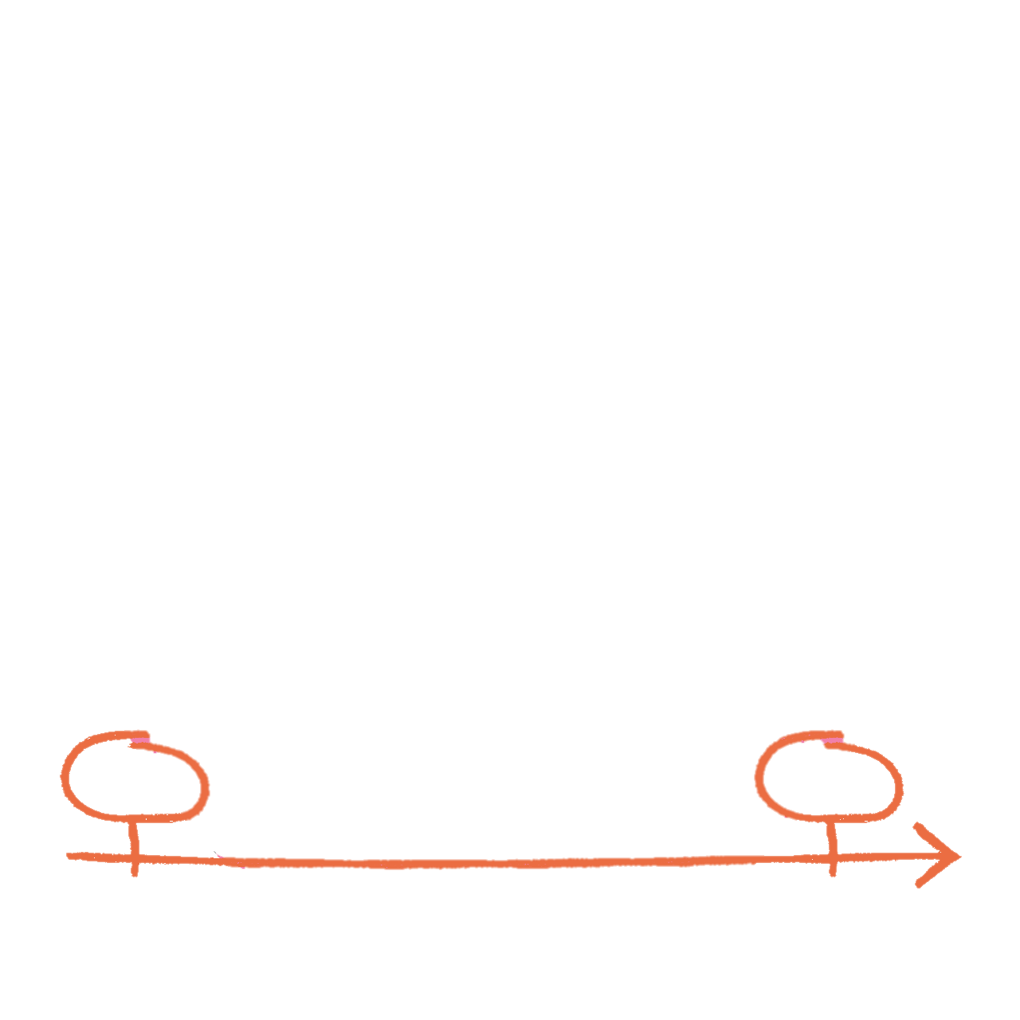
ENTREPRENEUR
IDEA
BUSINESS
WANTREPRENEUR
IDEA
IDEA
@

Slide 11





Become Entrepreneur Not A Wantrepreneur
Wantrepreneur
Idea
Idea
Problem
Fail and quit
Plan & strategy
Action
@

Slide 12



Become Entrepreneur Not A Wantrepreneur
Entrepreneur
Idea
Fail
Try again
Plan & strategy
Solve it
Fail
Solve and scale
Action
Try again
Fail
@
Problem

Slide 13
Beginner Mistakes As An Entrepreneur
Mistake #1 No plan
Mistake #2 spending too much money first
Mistake #3 Expecting fast results for no effort
Mistake #4 Hiring too soon
Mistake #5 Not surveying the potential clients
Mistake #6 copying others
Mistake #7 Not passionate about your idea
Mistake #8 Doing it along
Mistake #9 thinking busy is productive
Mistake #10 Not starting Today
Harsh raj

Slide 14

THE MIND OF AN ENTREPRENEUR
Read on a daily basis
Revisit your vision on a daily basis
Put yourself in challenging situations
Approach problems from all sides
Always be in motive; provide value
Use networking to build your business
Failure is a part of the process
@

Slide 15

@

